Slide 1

eduvance From chalkboards to dashboards
Presented By
Laiba Khan (2022-CS-70)
Fasi-ur-Rehman (2022-CS-71)
Alishba Mazhar (2022-CS-74)
Wali Allah (2022-CS-86)
Presented To
Dr. Syed Khaldoon Khurshid

Slide 2
Agenda
Project Introduction
Project Planning & Tools
Challenges & Solutions
Progress & Current Status
Methodology
Conclusion & Q/A

Slide 3
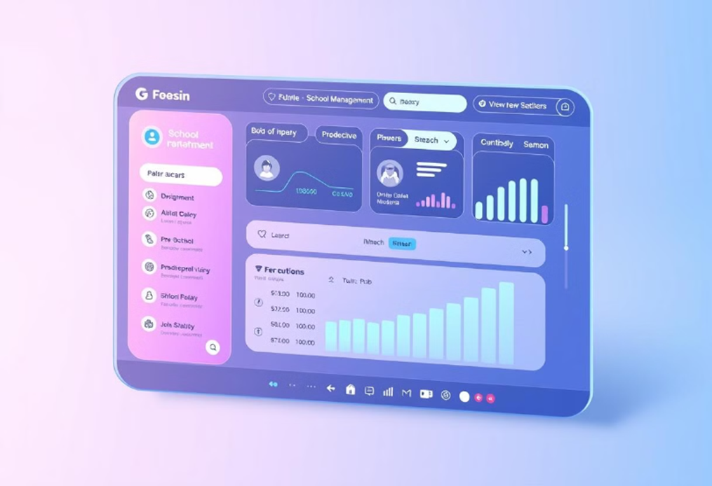
Project Introduction
Problem Statement
Education lacks efficiency and personalization in traditional systems.
Objective
Streamline operations and enhance user experience.
Market Gap
Schools lack AI-driven automation, limiting efficiency and personalization.

Slide 4
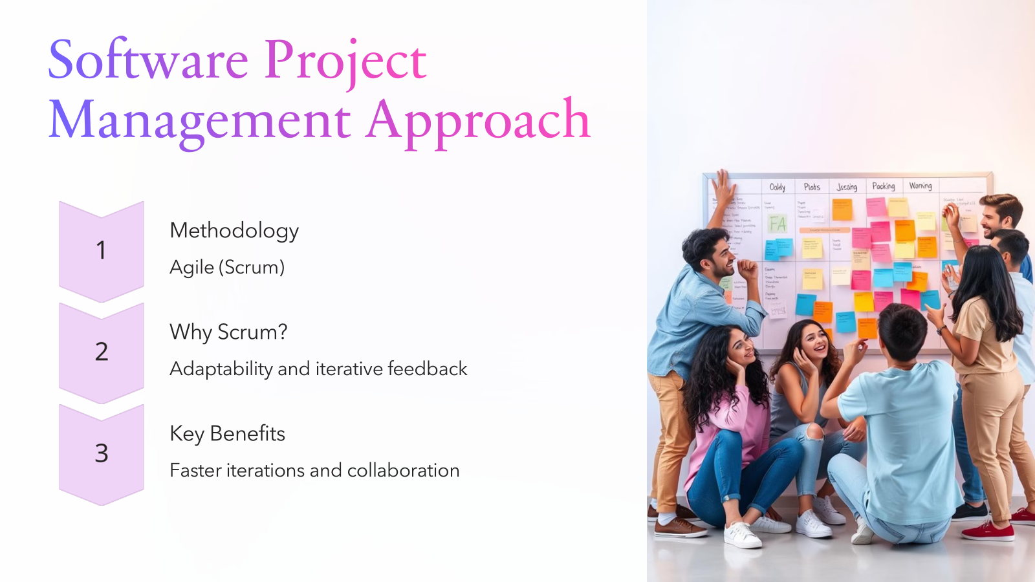

Slide 5
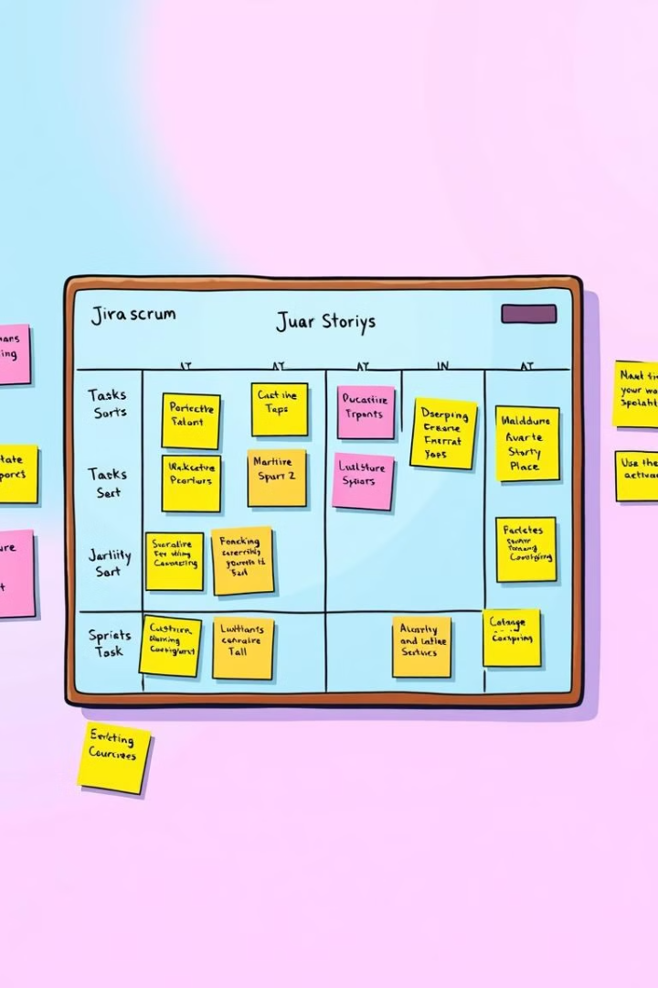



Project Planning and Tools
We chose Jira as our project management tool. URL: https://www.atlassian.com/software/jira
Organized Tasks
Tracked Sprints
Sprint Board
User stories and epics in Jira
Visibility into progress
Sprint Board & Summary

Slide 6
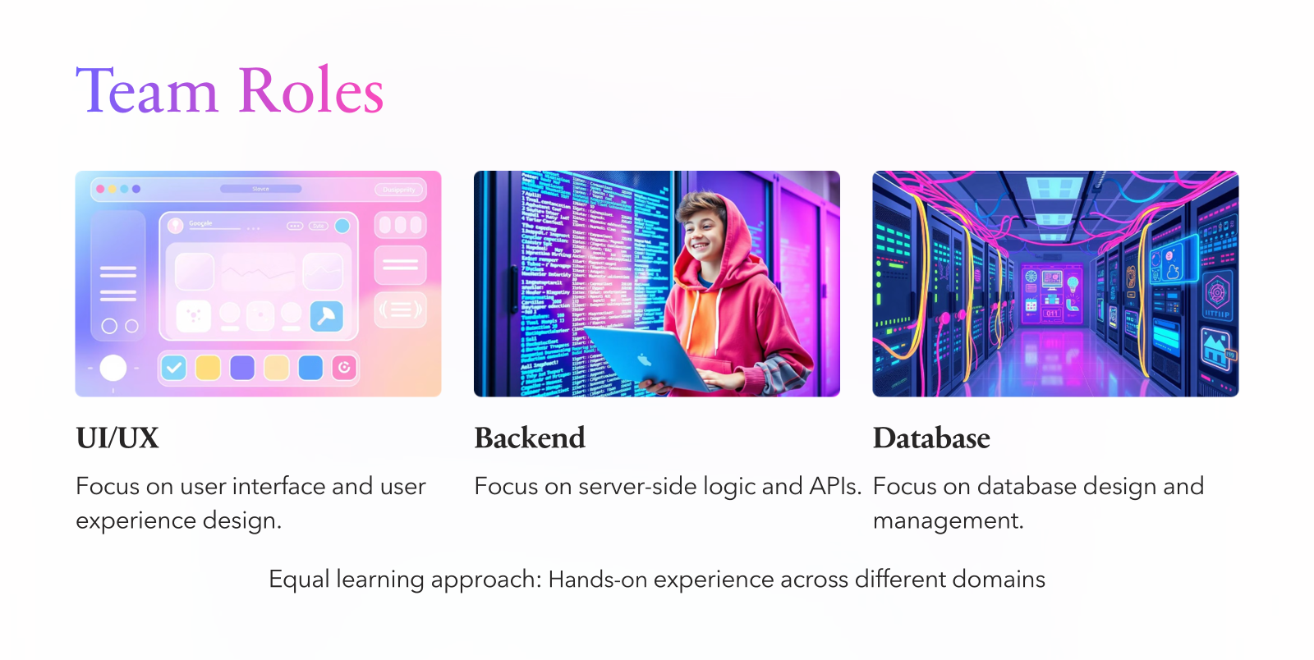

Slide 7
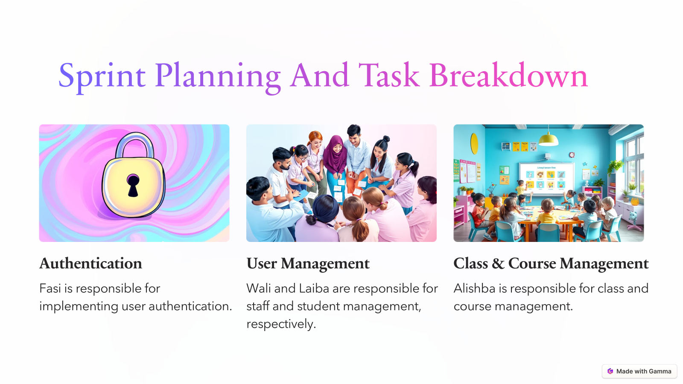

Slide 8
Challenges & Solutions
Effective team communication in an Agile environment.
Scalability concerns for future system expansion.
Managing API connections between modules.
Catching bugs early through iterative sprint testing
Gathering continuous input to align with project goals.

Slide 9
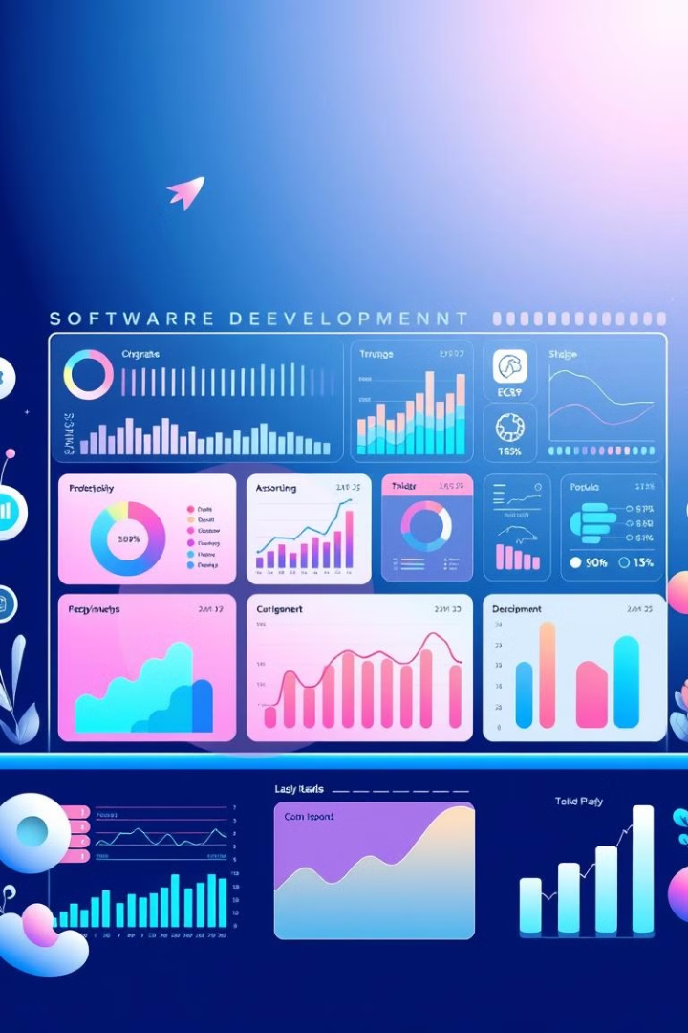
Progress & Current Status
35% UI
Completed Prototype
Project completion Finalized
Backend
Setup
Typescript

Slide 10

Thank you
Any Question?

Slide 11




Software Project Management Approach
Methodology
Agile (Scrum)
Why Scrum?
Adaptability and iterative feedback
Key Benefits
Faster iterations and collaboration

